Slide 1
Whole genome graph creation from multiple assemblies
CSHL Graph Genome group

Slide 2
Step 1: Align all Contigs to GrCH38
Input:
FASTA contig files (CHM1, CHM13, HG003, HG004, HX1, Korean, NA19240)
Reference FASTA (GRChr38)
Output:
BAM
Tools:
BWA
Notes: COMPLETE
Overheard: This is easy

Slide 3
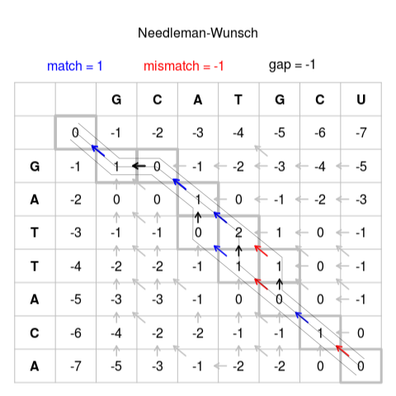
Step 1.1: Globally Align Contigs
Input:
FASTA files (contigs)
Reference FASTA (GRChr38)
BAM
Output: BAM
each contig has single alignment
Tools: Local to Global Alignment
Biederstedt extension of Needleman-Wunsch algorithm
Overheard: The edges are what, again?
https://upload.wikimedia.org/wikipedia/commons/3/3f/Needleman-Wunsch_pairwise_sequence_alignment.png

Slide 4
Step 2: Divide & Conquer Multiple Sequence Align
Input:
BAM
Output:
BAM
Tools:
MAFFT (alignment)
Some C++/python/PERL code (chopping & reassembling)
Identify window coordinates* (start with windows of size ~10kb) in alignment file
Extract sequence data for each window
Convert window to FASTA format
Run MAFFT for each window [could be parallelized]
Reassemble* the individual multiple sequence alignments into a single alignment file
Overheard:Why are you doing this to me?
* These are potential bottlenecks, both in the current coding process, as well as implementation (they require serial processing)

Slide 5
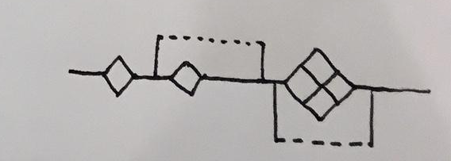
Step 3: Export Graph Genome
Input:
BAM
Output:
VCF (intermediate)
GFA
Tools:
Vg
Other wrappers
Overheard:When I do it by hand it works...

